Slide 1


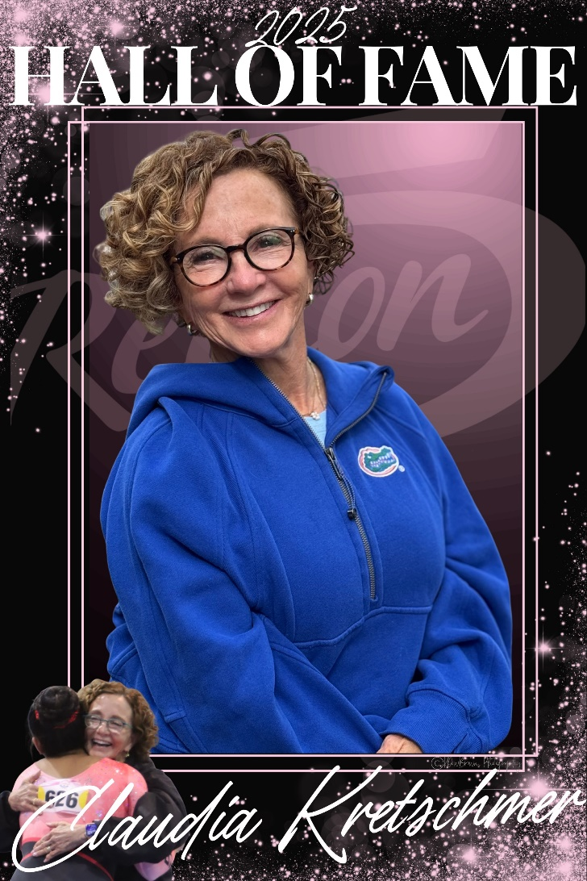
Claudia Kretschmer
Xcel Program Creator
National Coach
HALL
OF
FAME
Inducted 2025

Slide 2
Claudia Krestchmer
Class of 2025
Claudia has dedicated her life to not just teaching strong gymnastics to her athletes but to also guiding them to develop character and integrity to carry them through life. She has been a gym owner for over 40 years with her program motto being “Gymnastics Today, Character for Life”. She lives this motto out every day in her leadership and coaching in her gym, as well as her leadership with USA Gymnastics.
Claudia has coached national champions at all levels including 9, 10, NCAA, and at the elite level. She helped these athletes reach their competitive goals with a positive approach to coaching that made gymnast of all levels feel safe, respected, and supported. Beyond those accomplishments, her dedication to her athletes and her will to help them find a home in gymnastics, as well as her innovative mind and spirt, have permanently impacted gymnastics in a way that will last forever.
In her efforts to give gymnasts a place in the sport they love, Claudia created the Xcel program (previously Prep Op) as an alternative to the Development Program (formerly JO). The drive behind this innovation was solely because there were athletes who loved gymnastics but did not have a pathway to continue in the Development Program successfully. She wanted to give them a way to continue and be successful in the sport they loved so she created a small program in Michigan to provide them that opportunity. That innovation was eventually adopted into a national program of USA Gymnastics. There are now thousands of athletes competing annually who otherwise
.

Slide 3
Clausia Kretschmer
Class of 2025
would not have a place in the sport of gymnastics. The trickle-down effects of this innovation are incomprehensible. The individuals who have had a positive and successful competitive experience in gymnastics because of Xcel, who then went on to become coaches themselves and pass that joy and passion for gymnastics forward, are innumerable. The impact Xcel has and will continue to have on the sport of gymnastics in the Unted States is positive, permanent, and incomparable to any other change or innovation in the sport in recent times. Claudia has served as the National Xcel Chair since 2013.
In 2018, Claudia stepped up to be a part of the interim board of directors after the resignation of the former board. At the time, she stated that someone had to step up and help make gymnastics a trusted place once again, despite the personal backlash that may happen. She prioritized improving the culture and sport of gymnastics and went above and beyond to repair the damage to the sport that had been done in prior years. On an annual basis Claudia has presented numerous lectures at regional and national congresses. She has also developed and taught the W200 Developmental Coaches Course for USA Gymnastics throughout the country. She continues to strive every day to make the sport of gymnastics a positive and successful experience, not just for the athletes in her gym, but for the thousands of Xcel athletes throughout the country. Gymnastics in the United States is a stronger, more successful, and more positive sport because of the impact of Claudia Kretschmer and her tireless devotion to the athletes in this country.

Slide 4
Claudia Kretschmer
Class of 2025
SERVICES
Owner and Director – Gym America Gymnastics 1979-present
National Xcel Chair – 2013 – present
Interim Board of Directors, Women’s Gymnastics Program Council – 2018-2019
Meet Director of two annual meets in Michigan – Wolverine Classic and Girl Power. Girl Power annually donates proceeds to breast cancer research at the University of Michigan Hospital. To date Gym America’s Girl Power competition has donated over $90,000.00 to Michigan medicine.
Creator and President of Kick Start Strong LLC, a strength, conditioning and flexibility program for Michigan USAG athletes.
Founder of Shine Creative, a company that develops games to utilize in practice to help build gymnastics in a joyful and positive way.
PUBLICATIONS, CLINICS AND LECTURES
W200 Development Coaches Course-Developer and National Instructor
Annual presenter at Regional and National Congresses with lectures including but not limited to:
  Xcel Program Update
  Xcel 101: Navigating Xcel and Utilizing the Resources Available
  Xcel Floor Routine Construction
  Xcel Time Management: Utilizing Your limited Time in the Gym
  Hands On Spotting
  Creative Choreography
  Effective Beam Complexes
AWARDS AND ACCOLADES
2002 USA Gymnastics Outstanding PDP Instructor
2004 USA Gymnastics Outstanding PDCP Instructor
2010 Region 5 Contributor of the Year
2013 USA Gymnastics Educational Services Award
2013 USA Gymnastics Service Star Instructor Award – Women’s Artistic Program
2018 Michigan 5 – year Service Award

